Slide 1
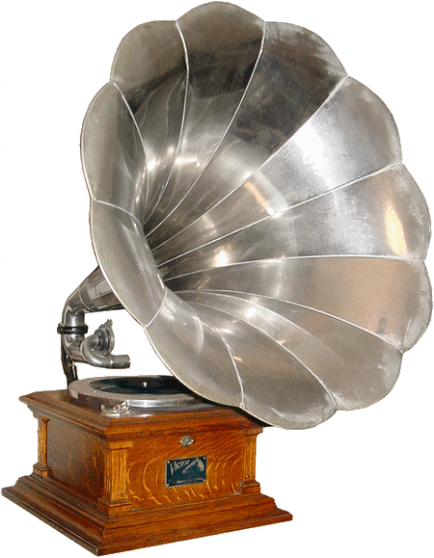



Welcome to Jukebox
By Selvam k

Slide 2

The Jukebox
a coin-operated phonograph or compact-disc player that automatically plays recordings selected from its list.
My Program is based This, but in Digital form

Slide 3
How I Develop Jukebox by Programming…?
I used Java and MySQL to recreate the Mechanical jukebox in to a digital form
I provide flexibly to organize once Playlist where they can able to add specific songs from the Music database. Which is Organized by separate table within the Database.
Where the song Primary Key is the Foreign key references for the Custom Playlist Table.
They can even alter the Playlist by means of add or deleting songs from the playlist with the references from the song table.
The songs can even be Played by means of Name, Artist and Album for Customized play Experience.

Slide 4

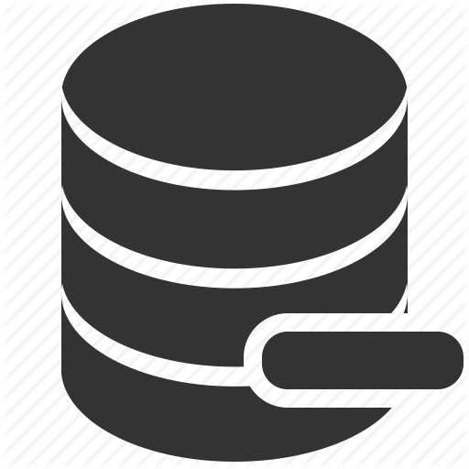

My Structure of database
JUKEBOX
This is my database were all the tables is been created and store for future use..
SONG TABLE
This stores all the details of the songs like song name, album, album, Duration and main this is URL to play the song
PLAYLIST NAME TABLE
This table stores the playlist name as the creates the playlist table.
PLAYLIST TABLE
This is the actual Playlist table that stores the song_id as the foreign key it table as also primary Key with playlist name. This table is created based on the number of play list created.

Slide 5
Tree Structure of MY java program
This java program is based on MVC Architecture which stands for Model-View-Controller(MVC)
MODEL
SongModel
Search
PlayList
MODEL which represents the logical structure of data in a software application and the high-level class associated with it. This object model does not contain any information about the user interface.
VIEW
VIEW , which is a collection of classes representing the elements in the user interface (all of the things the user can see and respond to on the screen, such as buttons, display boxes, and so forth)
AllSongs
Menus

Slide 6
Tree Structure of java program
DAO , Data Access Object (DAO) pattern, That separates a data resource's client interface from its data access mechanisms this Package is response or Database Connection Process
DAO
Audio
Dao
DaoPlaylist
CONTROLLER
CONTROLLER , which represents the classes connecting the model and the view, and is used to communicate between classes in the model and view.
SongMainImpl
PlaylistImpl
SongSearch
AudioGPO

Slide 7
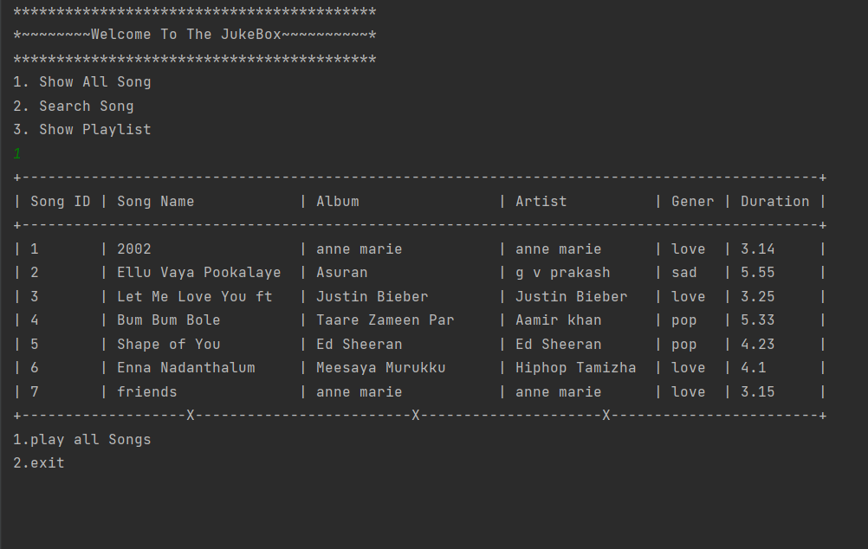
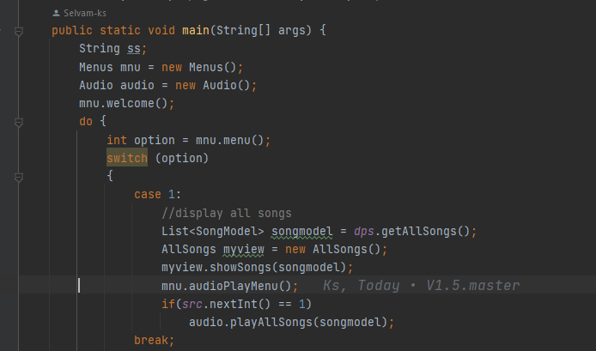
Display menu
The out put which is showing in the Image is where the get all the available song as a table as show , where user can chose according to his requirement to play the song.
In this all show is been selected as an example
Where it will ask for the whether , they want to
Paly the song list or need exit to the Menu
Which is in a loop .

Slide 8
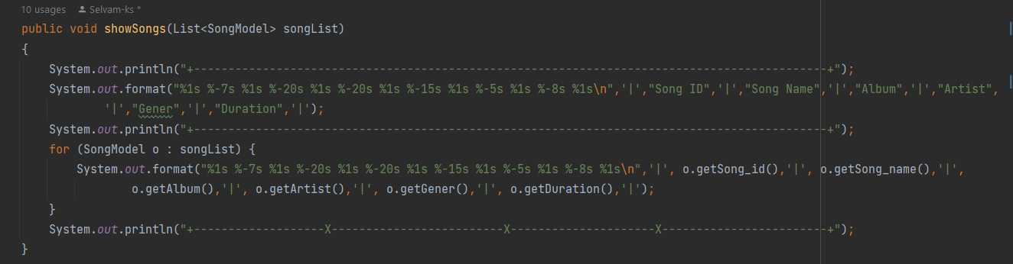
Display table in format
This is a Single display method which is responsible for show the song list to the user as a tabular form for the entire program . Which is archive by format method. What can create the structure of the table mased on the fixed number of prints column by mean of the string length
Which is fixed while creating the format stamens.

Slide 9
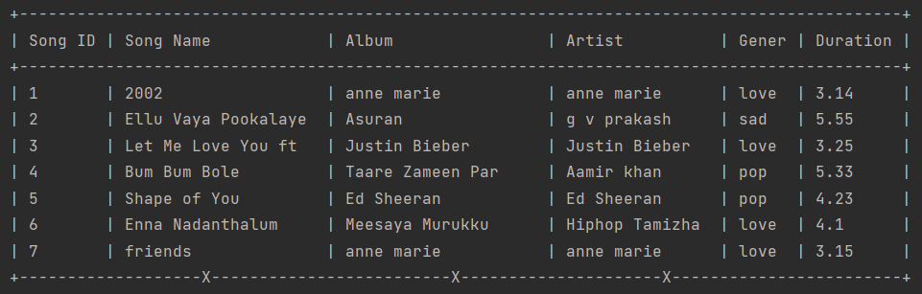
Table view
Table view is based in Format method

Slide 10
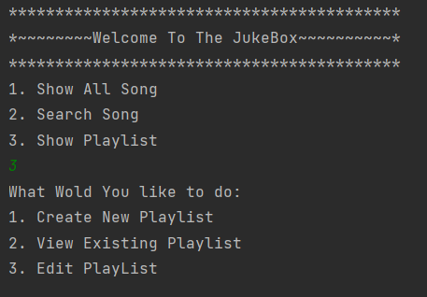
Playlist menu
Then playlist menu is Special feature were a user can create
there Own playlist by add few specific songs from the
database to enhance The user experience.
CREATE NEW PLAYLIST
if a user desired to create his own personal Playlist here come this option which helps them to personalize the Songs list.
VIEW EXIXTING PLAYLIST
Some of the user might have created thereOwn playlist. Here comes this option ,where it shows all the playlist Which are created by the user already.

Slide 11
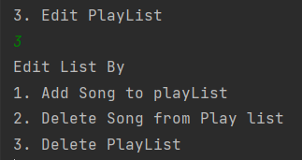
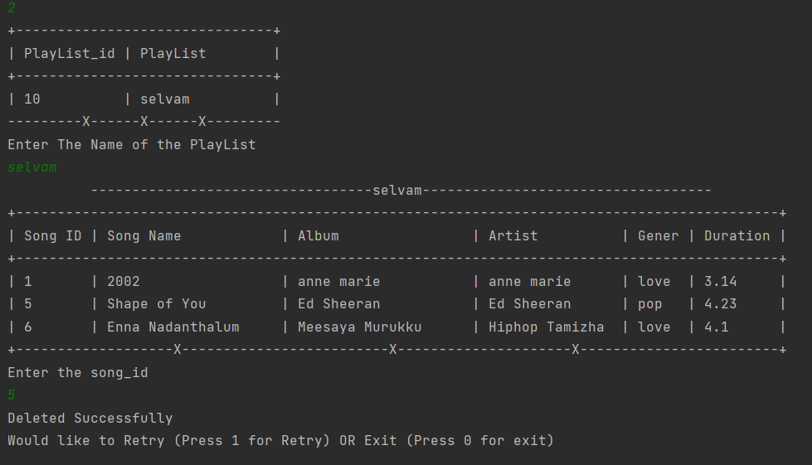
Edit playlist
Edit Feature is one of the key feature , like once a user is wishing to edit his playlist by adding Songs, Deleting the songs or ever Delete playlist which he Created for.
Delete Song from Playlist
I this option the user must to select the playlist in order to perform the further process , the deletion is performed based on the song_id .

Slide 12
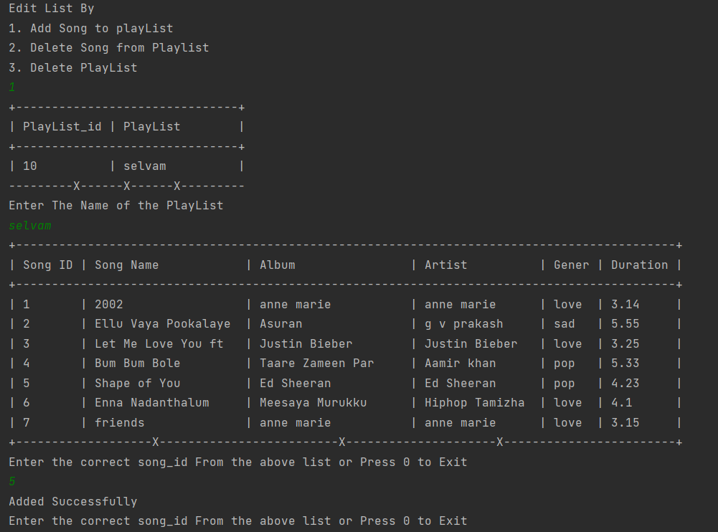
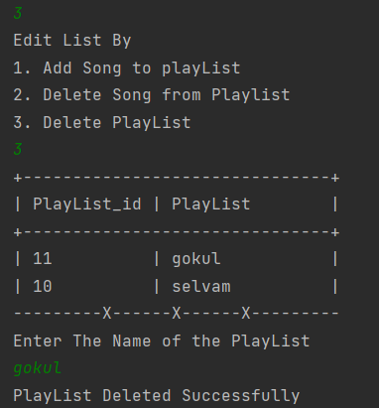
Add Song from Playlist
I this option the user must to select the playlist in order to perform the further process , the addition is performed based on the song_id and the song can not be repeated as it will it will create the duplicate entry.
Delete Playlist
This helps to delete the entire playlist from The database permanently.

Slide 13
Audio Processing
In order to play audio we have to import few class and interfaces like
AudioInputStream
AudioSystem
File
The above object are very import to play audio

Slide 14
Audio User interface
This digital Console is where the
play, pause, resume, Stop, Restart , Loop and
Nest process are been cared over to enhance the user experience for lessoning the song As the terms shown it will do the needs as respect like,
Play , It will play the song
Stop, It will stop the current playing song and set the sample length to 0 (it will reset the song to 0 potion)
Pause, I t will stop the song at the potion where you paused
Resume, it will resume the song if we pause it,
Restart , if we stop a song it will close the clip, what if we want to paly the stopped song …! Here comes restart ,which it will reopen the stopped song.
Loop, It will replay the current playing song in a loop

Slide 15
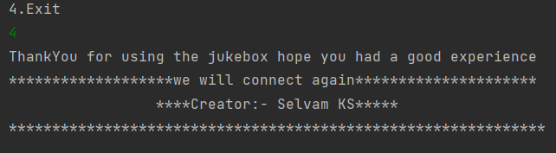
Exiting the Jukebox

Slide 16
Thank you

